Slide 1

STUDENT DATA ANALYSIS
Data Storytelling & Statistical validation

Slide 2
PROBLEM STATEMENT
To analyze student demographic and enrollment data
To understand distribution across gender, age, course, and academic year
To identify patterns and trends in student data
To support better academic planning and decision-making

Slide 3
Objective
To analyze student demographics
To identify trends across key attributes
To extract meaningful insights from data
To validate findings using statistical methods

Slide 4
Dataset Overview
Total students: 1000
Attributes:
Age
Gender
Date of the birth
Gender
Course
Year
City
Email

Slide 5
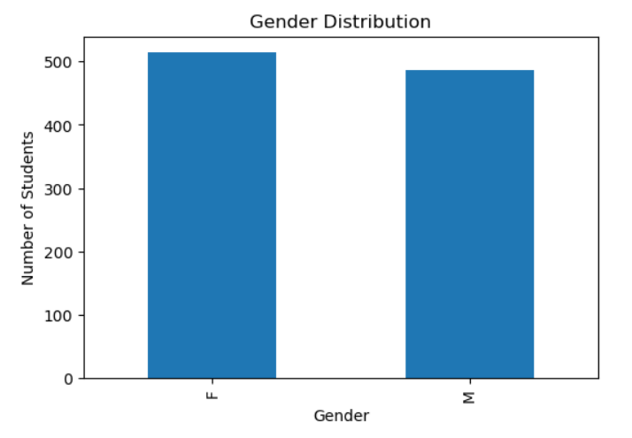
Gender Distribution
Female: 514 (51.4%)
Male: 486 (48.6%)
The dataset shows a balanced gender distribution among students.

Slide 6
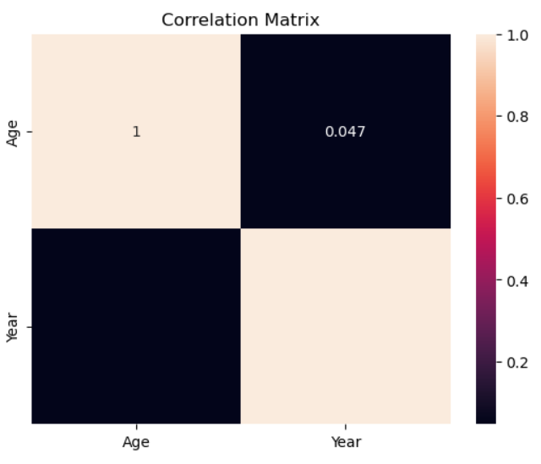
Correlation Matrix
Age vs Academic Year
Analyzed relationship between student age and academic year
A slight positive trend is observed between age and year
However, the relationship is not strongly linear
Indicates variation in student progression across years

Slide 7
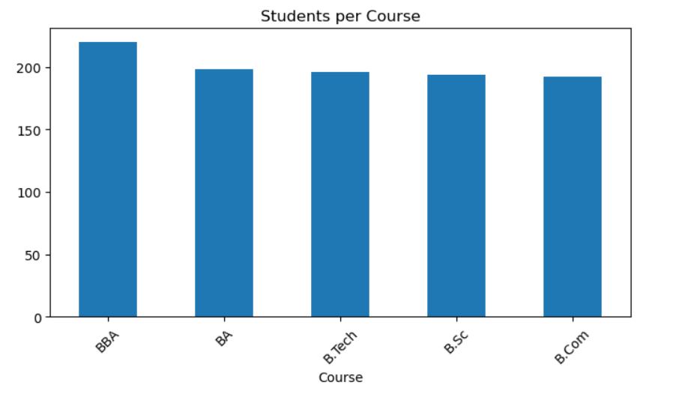
Some courses have higher enrollment than others
Indicates variation in course popularity
Helps identify high-demand academic programs
STUDENTS PER COURSE

Slide 8
KEY INSIGHTS
Academic year distribution is uniform, showing stable enrollment
Gender distribution is balanced, indicating inclusivity
Age distribution follows a normal academic pattern
Certain courses have higher enrollment, indicating popularity

Slide 9
HYPOTHESIS
Business Question: Do students in higher academic years tend to be older?
H₀ (Null Hypothesis): There is no significant difference in age across academic years
H₁ (Alternative Hypothesis): There is a significant difference in age across academic years

Slide 10
Business Insights
The student distribution is balanced across gender and academic years
Age consistency indicates smooth academic progression
Lack of strong age–year correlation suggests flexible academic pathways

Slide 11
Conclusion
No major demographic imbalThe student dataset shows a stable and balanced structure ances were observed
The institution demonstrates efficient academic management

